Slide 1

Sexual Orientation and Gender Identity
Ivan Garcia & Daniel Donenfeld

Slide 2

Introduction
Notes:
Brief Introduction:
Think about your most notable feature. Maybe it's your colored eyes, or your nice nails. Maybe it’s your long hair, or the way you can imitate animal noises. Now think about this: your most salient feature may not be a feature at all. To others, your most salient feature is your most basic feature: are you male or female?
Gender identity is what dictates how we talk to others, the groups we’re in, and how society sees us. These decisions are made based on our anatomy, and have been judged for many centuries. But what is gender identity in the first place? According to The Human Rights Campaign website, Gender identity is “One's innermost concept of self as male, female, a blend of both or neither – how individuals perceive themselves and what they call themselves. One's gender identity can be the same or different from their sex assigned at birth.” This definition is completely different from what we’ve seen in our history, and if you were to argue with a doctor about this issue 60 years ago, they would call you crazy.
Sexual orientation discrimination is when people are not treated fairly because of their sexual orientation, or association to someone of a different orientation. Although It is quickly becoming more accepted in today’s society, the discrimination almost always affects the LGBT community, and is seen as a choice that is frowned upon.
Recent studies estimate that between one and nine million children in the United States have at least one parent who is either lesbian, gay, or transgender.
The most common social justice issues are discrimination, homophobia, unfair labor practices, and violence. As per the FBI, approximately 20% of all hate crimes committed in America can be attributed to sexual orientation. It is not much of a surprise that trans women of color, extremely targeted characteristics, are the most vulnerable members of the LGBTQ community. These individuals constantly face problems such as transphobia and racism. Moreover, their skin color, regardless of their transgenderism, sets them up to fail in America’s system, so they are also vulnerable to poverty.

Slide 3
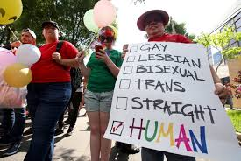
“Human rights are universal, indivisible and interdependent. They are not reserved for the few — they apply to everyone, everywhere. It is essential to reaffirm this fundamental principle and join forces to make it a reality.”
– Irina Bokova, Director-General of UNESCO
Notes:
Employment Discrimination:
Depending on the state, there are some laws that protect LGBTQ members from employment discrimination. Approximately 45 years ago, Pennsylvania took a huge step forward by becoming the first state in America to get rid of sexual orientation-based public sector employment discrimination.

Slide 4
What We Didn’t Know
There were no federal laws protecting people from sexual orientation and gender identity discrimination in the workplace, up until this year. (Ivan Garcia)
The majority of transgenders who plan on transitioning actually leave their companies before starting due to embarrassment and to avoid any harassment/backlash. (Daniel Donenfeld)
Even when appearing energetic and outgoing, many LGBTQ employees have deep-rooted depression due to their inability to come out formally to avoid demotion or even a firing. (Daniel Donenfeld)

Slide 5
What Shouldn’t Be Missed
One of the most recent decisions that was made on June 15, 2020 in regards to Title VII of the Civil Rights Acts.
3 specific steps HR should take when dealing with a transgender employee who intends on pursuing transition.
2 actions that could be taken to create a more equitable and/or inclusive environment for LGBTQ employee.
Notes:
These are three of the major points we feel that the audience should focus on, as one of them was a very historical victory that took place this month.

Slide 6

Section 1:
Societal Injustice Issues

Slide 7
Societal Stereotypes
“Gender is something you're born with.”
“Sexual identity is something that does not change over time”
“It’s all in your head”
Notes:
One of the biggest stereotypes / myths that we have been programmed to think is that we are born with our gender predetermined by the body parts we do or do not have. These parts will affect the cultural and societal development on how a person is raised. As they develop, children are able to identify themselves as boy or girl based on how they are treated and who they associate with (Yarber, 2012).
Another big stereotype / misconception is that sexual identity is something that you can’t change over time. Once you are a boy, you are a boy. This also ties with the third stereotype of “It’s all in your head” as many who identify as the opposite gender are thought to have mental disorder or be “sick”. Transgender has long been associated with poor mental health, and has been diagnosed as “gender identity disorder” or “gender dysphoria” (World Health Organization). In 2018, The WHO had removed transgender identity as a mental disorder, which helps the rest of the world accept it and remove stigma (World Health Organization). One of the biggest problems people face are social stigmas on the family, dealing with extended family members who may not be supportive, and finding a group of people who you can openly express your concerns (World Health Organization).
A study was done by the University of Hawaii to try and find out where the trait comes from (Diamond, 2013). Gender identity is genetic, as are most traits that involve identity They found one way to test this theory, which was to conduct twin studies (Diamond, 2013).
Among 31 of the transgender respondents, the average age claimed for a first awareness of being raised inappropriately and having a desire to be, or of being, of the “other” gender was 10 years or less for 19 (61.3%), with nine (29.0%) claiming it was before the age of 5 (Diamond, 2013). The average age of actual transition, however, was 32 years (Diamond, 2013). They also concluded that the identical twins were more likely to be both transgenders compared to fraternal twins, which means that it is in fact a genetic trait (Diamond, 2013).
There are many societal stereotypes that people have developed about sexual orientation and gender identity. First off, the idea that gender is something one’s born with and is thus set in stone. This is a massive misconception regarding the topic, as when one is born, their gender is, in fact, based on their biological buildup. However, as time progresses, people are impacted by their cultures and environments, which affects their growth, development, and understanding of their gender identity. Second, another societal stereotype regarding sexual orientation and gender identity is the notion that sexual identity does not change over time. Transgenderism has been associated with poor mental health for tens of years, and has thus been diagnosed as “gender identity disorder” or “gender dysphoria”. However, in 2018, The WHO removed transgenderism from being classified as a mental disorder, which progresses the rest of the world in accepting it and getting rid of the stigma. In childhood and early adolescence, there tends to be more sexual experimentation with people of opposite sex. Once this commences, it is common for there to be an uncertainty in sexual orientation. Amidst this period of uncertainty, one of the biggest problems people face are social stigmas in the family, dealing with extended family members who may not be supportive, and finding the right group of people who are open to hear any expressed concerns. Lastly, the “it’s all in your head” myth is a major one regarding this dimension of diversity. The University of Hawaii conducted an interesting twin study regarding transgenderism. Their conclusion was that identical twins were more often both transgender as opposed to fraternal twins.

Slide 8
Exclusion, Discrimination and Inequities Overview
Many LGBT employees face several types of discrimination in the workplace, such as:
Anxiety & Nervousness
Bullying & Abuse
Based on a 2011 survey, over 30% of employees who do not hide their sexual orientation were happy in their careers
56% of these people also reported some type of harassment, discrimination, verbal threats, or hate speech in the past 5 years
Source: Sears. B., Mallory, C. (2014). Employment Discrimination Against LBGT People: Existence and Impact. In Gender Identity and Sexual Orientation in the Workplace: A Practical Guide, Duffy, C. M. (Ed.) Bloomberg BNA, Arlington, VA, p. 40 – 1 – 40 – 19.
Notes:
Members of the LGBTQ community experience many challenges in their daily lives. They are treated in ways that are not up to par with how they deserve to be treated, as tends to happen to targeted identity groups. This mistreatment and exclusion prominently occurs in the workplace. Although LGBTQ people may seem energetic and ambitious in the workplace, a massive portion of them do not feel comfortable coming out of the closet. According to USA Today, nearly 50% of LGBTQ individuals in the workplace live in states where there had been absolutely zero laws that banned discrimination in the workplace. As per ABC News, however, the Supreme Court officially banned LGBTQ employment discrimination earlier this month. Sure, that was a step in the right direction. Nevertheless, it is simply unjust that only a few weeks ago was the first time the Supreme Court officially deemed this maltreatment towards LGBTQ’s in the workplace illegal.
Although this is a favorable outcome to an unfavorable situation, still approximately 34% of LGBTQ employees abstain from exposing their sexualities in the workplace (Qvist, para. 3). The main reason they engage in this behavior is to avoid any type of exclusion that may negatively impact their standing in their companies. In fact, with regards to transgender individuals who plan to pursue a gender transition, a great portion of these people will simply leave their companies during their transformation. This is not only sad, but also detrimental to the organizations they work at. They were hired for a reason, meaning they were some of the most outstanding and qualified candidates. This has nothing to do with their gender identity/sexual orientation, so it is a shame that this occurs often. If there was genuinely a more accepting outlook and approach at many of these companies, transgender people would feel comfortable going through transition while continuing work.

Slide 9
Exclusion, Discrimination and Inequities Overview (cont’d)
Violence – Nearly 1 in 5 hate crimes committed in the US was due to sexual orientation. (17%) [FBI 2015 UCR]
Of the 1,263 victims in 2015:
62% were crimes motivated by offender’s anti-gay bias
20% were victims of anti LGBT bias
Transwomen of color are the most vulnerable, as many face problems such as racism, transphobia, and frequently poverty, putting them at a higher risk for violence. [Global Citizen.org]
16 states don’t include sexual identity under their hate crime laws
13 only over sexual orientation
4 have no hate crime laws at all
Notes:
(Refer to previous slide for notes)

Slide 10

Example: Jesse Vroegh
In 2015, Mr. Vroegh’s, a registered nurse working in an Iowa prison, request of being allowed to use the men’s restroom and locker rooms was denied.
Mr. Vroegh was awarded $120,000 for workplace discrimination and for damages related to being denied insurance coverage for gender reassignment surgery.
“...the case was the first time that a transgender rights case had been successfully tested in Iowa since legislators amended the state’s Civil Rights Act in 2007 to include gender identity protections” (Hauser, 2019).
Source: Transgender Man Awarded $120,000 in Discrimination Case at Iowa Prison https://www.nytimes.com/2019/02/14/us/transgender-nurse-discrimination-case.html
Notes:
Jesse Vroegh knew he was male since he was 7 years old and in the third grade started to use the name Jessie to identify himself. He was transitioning from female to male at the time of the request. In the lawsuit, the Department of Corrections stated theirs concerns over the “rights of the male officers” and that transgender issues were “too controversial” (Hauser, 2019). He was awarded $100,000 for sex discrimination and $20,000 for discrimination in equal access to health care benefits (Hauser, 2019).

Slide 11

Section 2:
Legal Protection & Allies

Slide 12
Laws & Accepted Policies
The movement to obtain civil marriage rights and benefits for same-sex couples in the United States began in the 1970s but remained unsuccessful for over forty years.
On June 26, 2015 the Supreme Court ruled in Obergefell v. Hodges that states must license and recognize same-sex marriages.
Hate crimes based on sexual orientation or gender identity are also punishable by federal law under the Matthew Shepard and James Byrd, Jr. Hate Crimes Prevention Act of 2009. (Shepard, 2009).
Notes:
With marriage legal in the US, lesbian and gay employees should have access to the same workplace benefits that other heterosexual married couples do such as benefits and pensions.
Title VII of the Civil Rights Act:
Act was passed in 1964
Civil rights and labor law in the United States that bans discrimination dealing with color, sex, religion, race, or nationality
Abolishes an voting inequalities and racial segregation, specifically employment
However, this act does not yet apply to members of the LGBTQ community

Slide 13
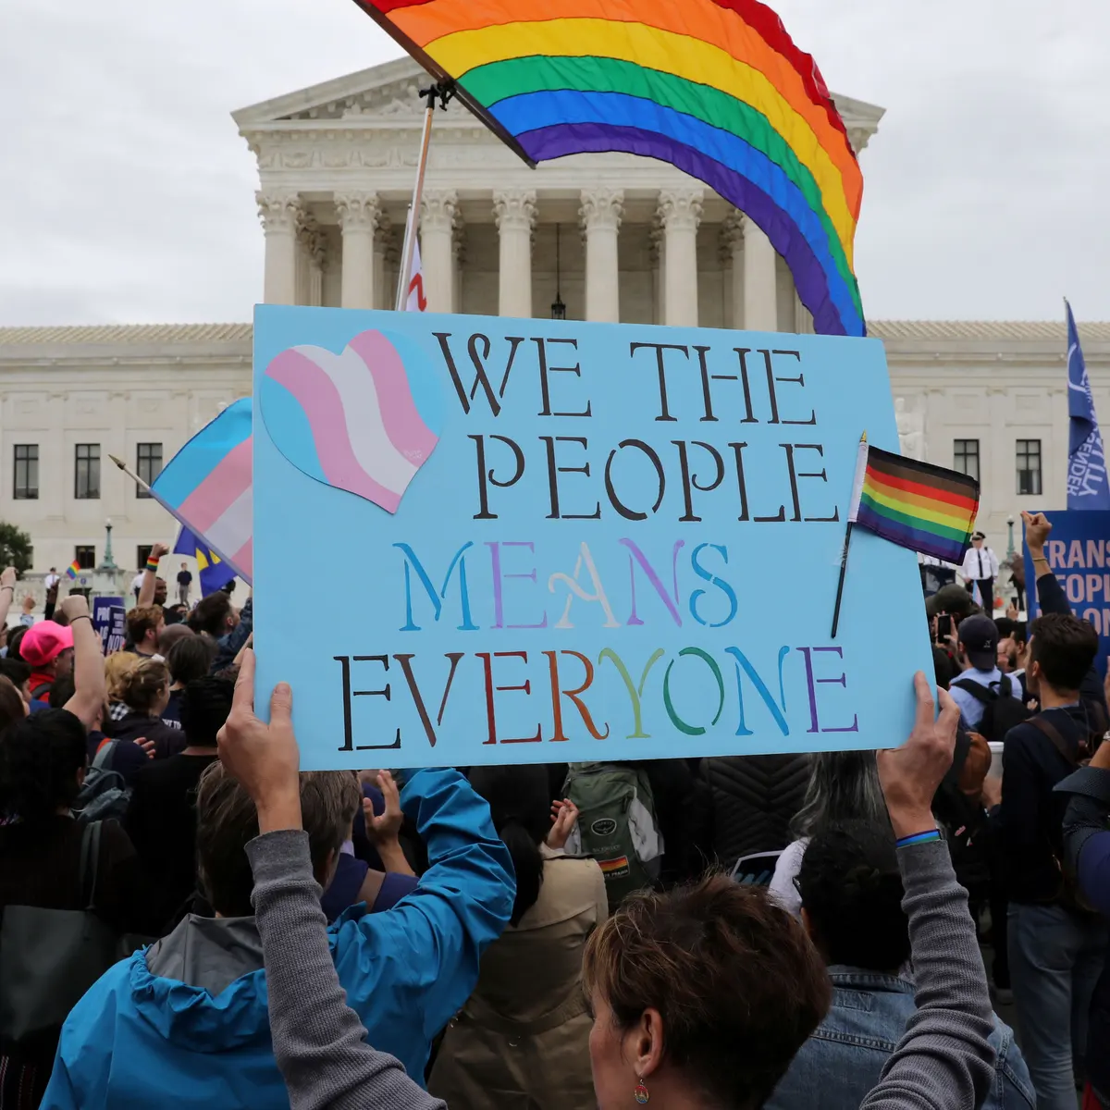
Laws & Accepted Policies (Cont.)
Boston v. Clayton County, Georgia
On June 15, 2020, the supreme court decided that the 1964 Civil Rights Act protects against employment discrimination based on sex which includes protections for LGBT workers.
Notes:
Before this, Title VII of the 1964 Civil Rights Act only mandated that employers do not discriminate on the basis of race, color, religion, sex (including pregnancy), national origin, age or disability. This is the first time that the LGBT community is protected and it is a huge turning point in becoming more accepted in the world. (Bostock, 2020).
Starting in the early 1970s, the movement same-sex couple benefits/marriages started to gain some traction
However, it was unsuccessful for over forty years
On June 26, 2015 the Supreme Court ruled in Obergefell v. Hodges that states must license and recognize same-sex marriages.
22 states respectfully, including Washington, D.C. and Puerto Rico, have outlawed discrimination based on sexual orientation and gender identity/expression
Hate crimes based on sexual orientation or gender identity are also punishable by federal law under Matthew Shepard and James Byrd, Jr. Hate Crimes Prevention Act of 2009
Recently on June 15, during the decision of the “Bostock v. Clayton County, Georgia” case, the Supreme Court decided that the 1964 Civil Rights Act protects against employment discrimination based on sex which includes protections for gay and transgender workers
This is a historical victory for them
Federal law mandates that employers do not discriminate on the basis of race, color, religion, sex (including pregnancy), national origin, age or disability
This is the first time a federal law protects LGBT people, and is a huge turning point in becoming more accepted in the world

Slide 14
Advocacy Groups
Family Equality Council
Founded in 1979 at the National March on Washington for Lesbian and Gay Rights, the organization that grew into Family Equality was formed in order to provide assistance to parents who faced sexual identity discrimination.
Their main focus is to help parents who are being denied equal opportunities just because of their sexual identity.
Source: New Family Equality Council Survey Reveals Dramatic Growth in LGBTQ Family Building. (2019, February 06). Retrieved June 30, 2020, from https://www.familyequality.org/press-releases/new-family-equality-council-survey-reveals-dramatic-growth-in-lgbtq-family-building/
Notes:
Many LGBT families are searching for help, as the states (Prior to June 15, 2020) did not protect against discrimination in the workplace. This makes it difficult for them to be able to sustain a steady income and to provide for themselves. With the Family Equality Council, they are not only able to find the right resources to start a family, but they also are able to look for jobs where they would more likely fit in and be accepted. Their goal is to connect LGBTQ families all over the nation, educate them on parenthood, sharing these stories with friends, and provide opportunities for them to speak out and take action.
Some statistics based on LGBT families are as follow:
63% of LGBT Millennials (aged 18-35) are considering expanding their families, either by becoming parents for the first time, or by having more children (New Family, 2019)
48% of LGBT Millennials are planning to grow their families, compared to 55% of non-LGBT Millennials (New Family, 2019). The gap is closer now compared to older generations plans on growing families
63% of LGBT people planning families expect to use assisted reproductive technology, foster care, or adoption to become parents, (New Family, 2019). This is a huge change in ideologies compared to heterosexual parents who become parents through intercourse
Family Equality Council
Started in the late 1970s at the National March on Washington for Lesbian and Gay Rights
Created as a result of the frustration with the fundamental inequality that was evident:
This being that parents are denied equal opportunity to start families due to their sexual orientation/gender identity

Slide 15
Advocacy Groups (Cont’d)
The Trevor Project
The leading national suicide prevention services for LGBTQ young people under 25.
They provide 24/7 online chats, texts, a social networking site, and trained counseling for anyone under 25.
They are non-profit and offer confidential services with trained counsellors
Key Successes: Over 90% of respondents de-escalate their level of crisis even 2 weeks after interventions
Transgender Law Center
Largest American transgender-led civil rights organization in the United States
Became California's first state-wide transgender legal organization.
Provide legal assistance and workshops to over 3,000 black transgenders nationwide
Key Successes: This organization has won many cases such as Ash Whitaker's, Shiloh Quine’s, and developed groups such as TRUTH, Black Trans Circle, and Positively Trans
Notes:
The Trevor Project was founded in 1998, and has been the leading national suicide prevention service for LGBTQ people for over 20 years.
With over 5 million LGBTQ people in the united states, they are able to only help 5% due to lack of exposure (Saving Young, 1). A study was done at the University of California and they found out that 74% of people weren't sure they would seek other help if the Trevor Project did not exist (Saving Young, 1). By extending their programs via phone and online, they aim to reach a larger audience and provide assistance 24/7, anywhere in the country. The program recently partnered with the NYC Dep. of Education in order to educate teachers and staff on the suicide prevention tools that are available.
The Transgender Law Center focuses on challenging the legal system and fighting for trans rights since 2002(Our Legal, 1). These systemic battles range from prison rights, black and brown right, healthcare, and trans youth.They became California’s first state wide transgender legal organization, and have won multiple cases such as Ash Whitaker; a 16 year old who was violated and discriminated of his right to use the boy’s restroom as a transgender male. These cases led to big changes in the law, such as LGBTQ protection under the 14th amendment.
Sources:
Saving Young LGBTQ Lives. (2020, June 25). Retrieved June 30, 2020, from https://www.thetrevorproject.org/
Family Equality - Advancing Equality for LGBTQ Families. (n.d.). Retrieved June 30, 2020, from https://www.familyequality.org/
Our Legal and Policy Work. (n.d.). Retrieved July 01, 2020, from https://transgenderlawcenter.org/legal

Slide 16

Section 3:
In Today’s Workplace

Slide 17
What Do Employees Desire and Need?
Hostility must be eliminated
Subtle sexual orientation/gender identity based offensive jokes exist in the workplace
20% of Americans who identify as LGBTQ have gone through discrimination solely due to their sexual orientation and/or gender identity during the job application process (Waite, para. 2)
There must be fundamental improvements made in Corporate America’s system that allows for LGBTQ applicants to have equal opportunity
Compensation Equality
22% of LGBTQ Americans are both paid and promoted at significantly lower rates than their straight co-workers are (Waite, para. 4)
Notes:
Employees who self-identify with Diversity of Sexual Orientation & Gender Identity are indicating many things they need or desire in order to feel respected and included in the workplace, and rightfully so. Being non-dominate in the workplace can be challenging, especially with regards to sexual orientation & gender identity. To begin with, these people generally are just looking for equal opportunity; this is the end goal they want and deserve. The following items are specific ways that will enable the result to be a more equal opportunistic environment in the workplace:
Mitigate hostility towards them
This hostility could be either subtle or overt
LGBTQ employees face way too much hostility in the workplace
It is noted that 20% of Americans who identify as LGBTQ have gone through discrimination solely due to their sexual orientation and/or gender identity during the job application process (Waite, para. 2)
This is by no means acceptable. There must be fundamental improvements made in Corporate America’s system that allows for LGBTQ applicants to have equal opportunity
Compensation inequality exists in the workplace towards LGBTQ employees, as it is reported that 22% of LGBTQ Americans are both paid and promoted at significantly lower rates than their straight co-workers are (Waite, para. 4)
Subtle sexual orientation/gender identity based offensive jokes exist in the workplace
Employees who self-identify with Diversity of Sexual Orientation & Gender Identity are indicating many things they need or desire in order to feel respected and included in the workplace, and rightfully so. Being non-dominate in the workplace can be challenging, especially with regards to sexual orientation & gender identity. To begin with, these people generally are just looking for equal opportunity; this is the end goal they want and deserve. The following items are specific ways that will enable the result to be a more equal opportunistic environment in the workplace:
Source: Waite, S., & Denier, N. (2019, February 22). A Research Note on Canada's LGBT Data Landscape: Where We Are and What the Future Holds. Retrieved June 30, 2020, from https://onlinelibrary.wiley.com/doi/full/10.1111/cars.12232

Slide 18
What Do Employees Desire and Need? (Cont’d)
(3) Encourage them to feel comfortable expressing themselves, rather than having fear and cover
50% of LGBTQ American employees fall back on covering in the workplace (Waite, para. 8)
About 60% of straight employees claim that it is inappropriate and unprofessional to talk about sexual orientation and gender identity in the workplace (Waite, para.11)
This mentality is regressive. Must get past what is uncomfortable for people of dominate identities to speak about, and allow for non-dominant individuals to feel comfortable in the workplace
LGBTQ workers typically engage in covering elements of their authentic personalities as a method of limiting discriminatory backlash they may get hit with
Incredibly tiring and unfair for these employees, as they have to channel their energy towards covering their true selves rather than using this energy towards benefitting the company
Transgender workers who are en route to transitioning are unable to cover this, as it is very much a physical transformation
Notes:
Encourage them to feel comfortable expressing themselves, rather than having fear to do so and covering
LGBTQ employees feel that fear is a major restriction on their ability to feel comfortable in bringing their genuine selves to work; leads to covering
It is noted that approximately half of LGBTQ American employees fall back on covering in the workplace (Waite, para. 8)
A red flag is the following statistic: About 60% of straight employees claim that it is inappropriate and unprofessional to talk about sexual orientation and gender identity in the workplace (Waite, para.11)
This mentality is regressive. We must get past what is uncomfortable for people of dominate identities to speak about, and allow for non-dominate individuals to feel comfortable in the workplace by discussing these prominent issues
Due to this, LGBTQ workers typically engage in covering elements of their authentic personalities as a method of limiting discriminatory backlash they may get hit with
This is incredibly tiring and unfair for these employees, as they have to channel their energy towards covering their true selves rather than using this energy towards benefitting the company
An even bigger issue is that transgender workers who are en route to transitioning are unable to cover this, as it is very much a physical transformation
Sources:
Waite, S., & Denier, N. (2019, February 22). A Research Note on Canada's LGBT Data Landscape: Where We Are and What the Future Holds. Retrieved June 30, 2020, from https://onlinelibrary.wiley.com/doi/full/10.1111/cars.12232
Thisisloyal.com, L. (2020, May 17). LGBT People in the US Not Protected by State Non-Discrimination Statutes. Retrieved June 30, 2020, from https://williamsinstitute.law.ucla.edu/publications/lgbt-nondiscrimination-statutes/

Slide 19
What Do Employees Desire and Need? (Cont’d)
(4) Provide them with more leadership opportunities
Very rare to find openly LGBT corporate leaders
Beth Ford became the openly lesbian woman to run a Fortune 500 company, as the CEO of Land O’Lakes (2018) (Lesbian, para. 3)
This is a shame. Only 2 years ago was the first time an openly lesbian woman ran a Fortune 500 company
Sure, maybe this was the first time “a lesbian woman was qualified enough” to run a Fortune 500 organization, but that’s unlikely.
The discrimination is prominent.
Notes:
Provide them with more leadership opportunities
It’s very rare to find openly LGBTQ corporate leaders
Beth Ford became the openly lesbian woman to run a Fortune 500 company, as the CEO of Land O’Lakes (2018) (Lesbian, para. 3)
This is a shame. Only 2 years ago was the first time an openly lesbian woman ran a Fortune 500 company; sure, maybe this was the first time “a lesbian woman was qualified enough” to run a Fortune 500 organization, but I find that hard to believe. The discrimination is prominent
Source: Lesbian, Gay, Bisexual, and Transgender Workplace Issues: Quick Take. (n.d.). Retrieved June 30, 2020, from https://www.catalyst.org/research/lesbian-gay-bisexual-and-transgender-workplace-issues/

Slide 20

Institutional and/or Interpersonal Opportunities for Equity and Inclusion
In order to create a more equitable and inclusive environment for LGBTQ employees, serious actions must be taken.
Must be made by employers (programs, policies, culture)
Impacts coworker interactions (follow > initiate)
Must start at the highest levels
This can lead to significant changes
Those who choose not to follow can then face serious consequences
Notes:
In order to create a more equitable and inclusive environment for LGBTQ employees, serious actions must be taken.
These actions must be made by employers (institutional policies, programs and culture), which will then impact co-worker interactions (interpersonal behaviors). The way humans work, it is much easier for us to follow than to initiate. Thus, these changes must start at the highest level of a given organization. Furthermore, if the actions that are taken essentially become rules within an organization, there could be significant consequences if employees engage in bigotry towards LGBTQ employees.

Slide 21
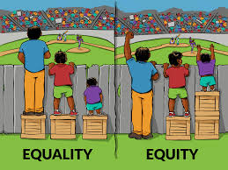
Steps On How to Introduce Equity and Inclusion
1: Companies must create step by step procedural plans for supporting LGBT employees
Must be created by upper management (HR)
ex: mandatory diversity training, educational videos, and programs that must have a passing grade in order to show understanding of the concept
This can help transition the ideology for those who have never heard of it/did not take it seriously
Notes:
First, companies must create step by step, procedural plans for supporting LGBTQ employees in the workplace. This plan must originate at the top of organizations in their HR departments, where a clear plan is laid out to all employees. A very effective way for this mission to be facilitated is through diversity training and education that all employees must partake in, and earn a high grade on the test enough after learning. This training would describe the organization’s policies that would seamlessly ease into a more inclusive workspace for LGBTQ employees. This fundamental change would slowly start to get rid of discriminatory tendencies towards LGBTQ employees - the main reason for this is due to how serious it is once it becomes an organizational prerequisite. Not only will it be looked down upon to engage in discrimination towards this group of people, but it will simply go against the company’s guidelines, which could result in serious punishments dealing with the firing of employees displaying this behavior and, potentially, law-related issues.

Slide 22
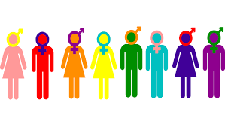
Steps On How To Introduce Equity and Inclusion (Cont’d)
2: Starting programs for LGBTQ workers
Companies can initiate ERGs
This will create an accepting company culture and find new ways to progress as a company.
Adapt a gender neutral environment in order to make LGBTQ employees feel more comfortable
Gender neutral language in documentation, gender neutral bathrooms, etc.
Notes:
Second, starting alliance/support programs for LGBTQ workers within companies can certainly create a more inclusive environment. Certain programs, such as networking groups, may have substantial benefits when considering ways to develop a more inclusive workplace for LGBTQ employees. Moreover, tying back to creating missions for supporting these employees, companies can also initiate Employee Resource Groups (ERGs). In order for ERGs to be successful, there must be open dialogue occurring on a consistent basis; this will not only create a more accepting company culture, but it also will consistently pioneer new ways to continue progressing the workplace. Lastly, it is essential to adapt a gender neutral environment in order to allow for LGBTQ employees to feel more comfortable. Fostering an environment like this is not too difficult. All that really needs to be done are small changes such as making all bathrooms gender neutral, using gender neutral language in documentation, etc.

Slide 23

Section 4:
Interesting Issues About this Dimension

Slide 24
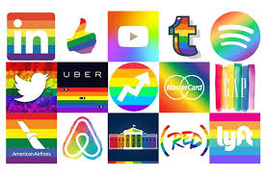
Transgenderism in the Workplace
Companies that refuse to accept transgender only face backlash in the long run.
Allowing them to embrace themselves will help the company’s moral values and is seen as good business practice (win-win!).
When employees are happy, they become more creative / productive
The more proactive the organizations, the smoother the process is likely to be
Notes:
There are many important concepts associated with transgender employees in the workplace. Frankly, companies that are not ready to allow for transgenders to go through gender transitions will not only face employee related backlash, but also potential discrimination charges. With that in mind, allowing for transgender individuals to embrace their true selves not only compiles with morality, but it also is good from a business perspective (win-win situation). With transgenders in the workplace, organizations can become significantly more creative and productive. Including transgenders gets rid of the limitations of fit candidates who happen to be transgender and would otherwise be excluded. Additionally, when organizations no longer treat transgenders differently due to their gender identity, but rather view them based on their abilities from an unbiased standpoint, these employees will feel far more comfortable in their own skin, thus driving better performance. As with any organizational transition, the more proactive the organization, the smoother the transitional process is likely to be. That theory applies to organizations’ transitionings that allow for transgender employees to genuinely express themselves and feel comfortable.

Slide 25

Transgenderism in the Workplace (cont’d)
What should HR do?
1: Schedule a meeting with the employee
Allow the employee to talk about what they are comfortable with only.
Talk about the employee’s expectations after transitioning
2: Schedule another meeting with upper management
This will week them informed on the plans moving forward.
Create a step by step plan in which both parties agree on.
3: Final meeting with coworkers
This will be included in order not to catch anyone off guard with the transition, and so they are informed on the plan moving forward.
This does not require the employee to be present, so the answers and discussion can be more honest and unbiased.
Notes:
There are several steps HR departments must take when a transgender employee announces their plan to go through transition. To begin with, the department absolutely must schedule an initial meeting with the employee who’s decided to undergo the transition. Throughout this meeting, it is incredibly important to genuinely ease into the conversation and allow the employee to share only what they feel comfortable sharing. It is also a perfect moment to ask the employee exactly what they expect/would like to have happen, company-wise, through their transition. Following this meeting, there must be an additional meeting between the individual transgender employee spoke with in the first meeting and higher management, in order to keep the heads of the company informed on what the plan will be moving forward.
After this meeting, the transgender employee should have a meeting with the company heads to go over the finalized, step by step plan moving forward with the employee’s transition. By the end of this meeting, it is essential that all misunderstandings are settled and management sees eye to eye with the employee. Finally, after finalizing the plan, there must be a bigger meeting with all other company employees who regularly work with the transitioning transgender employee. In this meeting, employees will be informed of the situation and the plan the company has chosen to take. It is important to note that at this final meeting, the transgender employee should not be present, as it can allow the other employees to feel more free to further understand anything they may be confused about without hurting the transgender employee’s feelings.

Slide 26
Thoughts in Relation to the Topic
Transgenders must be a top priority at every company
Inclusive policies for transgenders must not only be recommended, but enforced critically
The main issue that arises with transgender employees is not necessarily solely their transgenderism, per say, but rather their transitioning period
Throughout this period, it may seem bizarre or unsettling for some co-workers to witness, which is why it is crucial that meetings are had between:
(1) the employee and a supervisor
(2) a supervisor and company heads
(3) company heads, a supervisor and the employee
(4) company heads and all employees who interact with the transgender employee daily.
If all of these steps are taken, not only will it lead to this specific transgender to feel more comfortable during their transitional period, but it will also set a company precedent and create a more inclusive environment that not only accepts transgender individuals, but celebrates them as well.
Notes:
Shared Team Opinion:
In brief -
Transgenders must be a top priority at every company, regardless of which industry they’re in. Inclusive policies and programs towards transgenders must not only be recommended, but enforced with critical, law-related punishments for those who disobey them.
There certainly have been improvements regarding Diversity of Sexual Orientation & Gender Identity over the years. However, as we are becoming more and more progressive as a society, there must be more and more advancements made in the workplace, in turn making it easy for transgenders to feel comfortable being themselves, and feel like they have a place at the table to contribute to major company decisions. Treating transgenders with respect in the workplace is genuinely not a difficult concept, but it definitely needs to be instituted within company policies, otherwise it will not be as effective with regards to enforcing it. The main issue that arises with transgender employees is not necessarily solely their transgenderism, per say, but rather their transitioning period. Throughout this period, it may seem bizarre or unsettling for some co-workers to witness, which is why it is crucial that meetings are had between: (1) the employee and a supervisor, (2) a supervisor and company heads, (3) company heads, a supervisor and the employee, and (4) company heads and all employees who interact with the transgender employee daily. If all of these steps are taken, not only will it lead to this specific transgender to feel more comfortable during their transitional period, but it will also set a company precedent and create a more inclusive environment that not only accepts transgender individuals, but celebrates them as well.

Slide 27

Bibliography

Slide 28
Bibliography
“BOSTOCK v. CLAYTON COUNTY.” Supreme Court of The United States, www.supremecourt.gov/opinions/19pdf/17-1618_hfci.pdf.
Diamond, Milton. “Transsexuality Among Twins: Identity Concordance, Transition, Rearing, and Orientation.” International Journal of Transgenderism, vol. 14, no. 1, 2013, pp. 24–38., doi:10.1080/15532739.2013.750222.
“Growing Recognition of Transgender Health.” World Health Organization, World Health Organization, 8 Dec. 2017, www.who.int/bulletin/volumes/94/11/16-021116/en/.
Hauser, Christine. “Transgender Man Awarded $120,000 in Discrimination Case at Iowa Prison.” The New York Times, The New York Times, 14 Feb. 2019, www.nytimes.com/2019/02/14/us/transgender-nurse-discrimination-case.html.
“New Family Equality Council Survey Reveals Dramatic Growth in LGBTQ Family Building.” Family Equality, 6 Feb. 2019, www.familyequality.org/press-releases/new-family-equality-council-survey-reveals-dramatic-growth-in-lgbtq-family-building/.
“The Matthew Shepard And James Byrd, Jr., Hate Crimes Prevention Act Of 2009.” The United States Department of Justice, 18 Oct. 2018, www.justice.gov/crt/matthew-shepard-and-james-byrd-jr-hate-crimes-prevention-act-2009-0.
Yarber, William L., and Barbara Werner Sayad. Human Sexuality: Diversity in Contemporary America. McGraw-Hill Education, 2016.

Slide 29
Bibliography (Cont’d)
Gassam, J. (2018, July 30). How To Create An Inclusive Environment For LGBTQ Employees. Retrieved June 30, 2020, from https://www.forbes.com/sites/janicegassam/2018/07/29/how-to-create-an-inclusive-environment-for-lgbtq-employees/
Human Rights Campaign. (n.d.). Coming Out in the Workplace as Transgender. Retrieved June 30, 2020, from https://www.hrc.org/resources/coming-out-in-the-workplace-as-transgender
Lesbian, Gay, Bisexual, and Transgender Workplace Issues: Quick Take. (n.d.). Retrieved June 30, 2020, from https://www.catalyst.org/research/lesbian-gay-bisexual-and-transgender-workplace-issues/
Managing Gender Transition In The Workplace. (n.d.). Retrieved June 30, 2020, from https://sso.shrm.org/IDBUS/SHRM/PORTAL-EE/JOSSO/SSO/REDIR?josso_cmd=login
Mitchell, R. (2019, October 09). Lessons in how to make the workplace inclusive for LGBTQ employees. Retrieved June 30, 2020, from https://news.harvard.edu/gazette/story/2019/02/lessons-in-how-to-make-the-workplace-inclusive-for-lgbtq-employees/
Rosenstone, N., & Nico Calvo Rosenstone currently advises corporations and foundations on LGBTQ inclusive policies. (n.d.). 'Trans-forming' the Workplace to Be Transgender Inclusive (SSIR). Retrieved June 30, 2020, from https://ssir.org/articles/entry/trans_forming_the_workplace_to_be_transgender_inclusive
Thisisloyal.com, L. (2020, May 17). LGBT People in the US Not Protected by State Non-Discrimination Statutes. Retrieved June 30, 2020, from https://williamsinstitute.law.ucla.edu/publications/lgbt-nondiscrimination-statutes/
Waite, S., & Denier, N. (2019, February 22). A Research Note on Canada's LGBT Data Landscape: Where We Are and What the Future Holds. Retrieved June 30, 2020, from https://onlinelibrary.wiley.com/doi/full/10.1111/cars.12232

Slide 30

Recommended Discussion Points

Slide 31
Questions for Discussions within Learning Community
In regards to the federal law that was revised on June 15, 2020 (Title VII of the Civil Rights Act), how will this positively affect the workplace environment?
Do you believe those in the community will be more comfortable with expressing themselves and not result to “covering”?
Do you think within the LGBTQ community, people face other types of discrimination aside from sexual orientation/gender identity based, such as racism?
If yes, how do you think they can help one another and be more inclusive instead of dividing themselves even further?
Are there any other types of inequalities within this community?
What are two possible actions that could be taken in order to create a more equitable environment for LGBTQ employees? Describe how these actions could lead to a more inclusive workplace for these employees.

